Slide 1
IT563: DATA MINING
Topic: Sentiment Analysis
and Emojification
-Saprem Shah
Submitted to:
Prof P.M. Jat

Slide 2
​Problem Definition
Classifying the polarity of a given ​text​ at the document,sentence, or feature/aspect level whether the expressed opinion is positive/negative/neutral.
Applications :
Shifts in sentiment on social media have been shown to correlate with shifts in the stock market.
Develop better products and improve customer satisfaction​.
The ability to extract insights from social data for better market analysis.
Social media monitoring as it allows us to gain an overview of the wider public opinion behind certain topics.

Slide 3
​Work
Many algorithms have proposed for sentiment analysis.
Why RNN better and intuitional than other methods ?
Technique tried in : to capture sentiment analysis in short text based on recurrent neural network LSTM and pre-trained word vectors word2vec.
Word2vec : Model to produce word embeddings.
Word-embeddings help us represent our words as vectors, where similar word-vectors are semantically similar.
Words can’t be used as data since operations like dot product, backpropagation can’t be applied. Hence the need of vector representation of words.
LSTM : are a building unit for layers of a recurrent neural network (​RNN​) and are explicitly designed to avoid the long-term dependency problem.

Slide 4
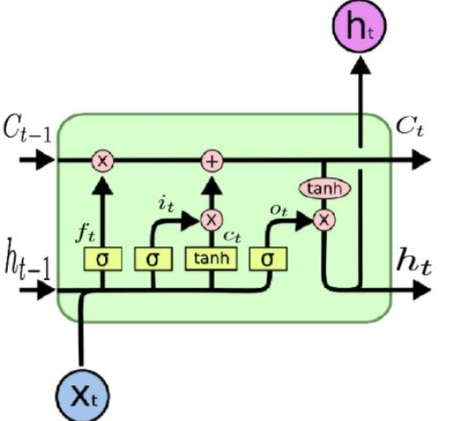
LSTM unit

Slide 5
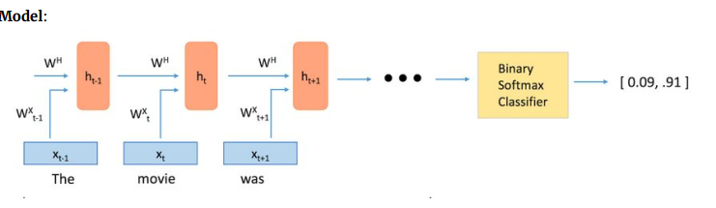
Model
DATASET : The dataset is compiled from a collection of 50,000 reviews from IMDB on the condition. Neutral reviews are not included.
I have implemented Sentiment Analysis with LSTMs using pre-trained ​GloVe​ vectors​

Slide 6
Model
Steps​:
1) Training a word vector generation model (such as Word2Vec) or loading pre-trained word vectors
2) Creating an ID's matrix for our training set (We'll discuss this a bit later)
3) RNN (With LSTM units) model creation
4) Training
5) Testing
HyperParameters (taken while training data)​:
Learning Rate - 0.001
Optimizer - Adam optimizer
Number of LSTM units - 64
Batch size - 24
Iterations - 100,000

Slide 7
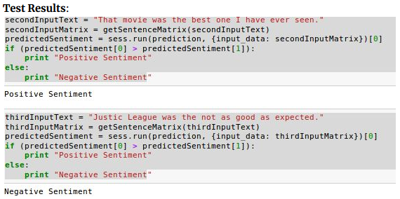
Test results

Slide 8
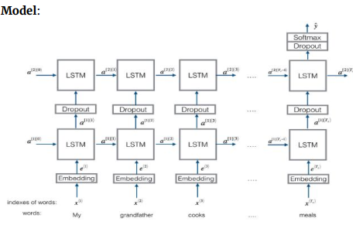
Further experimentation - Emojification
Emojify : An emojifier based on Sentiment Analysis (of small dataset) which based on the input sentence gives us it’s appropriate emoji from predefined 5 emojis taken into consideration.

Slide 9
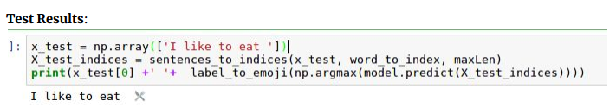
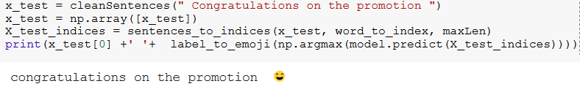
Emojify : Test Results

Slide 10
Comparison
Below are the accuracy I achieved for IMDB dataset for different approaches.
Naive Bayes (81.65%)
Random Forest (82.75%)
SVM with 10-fold cross validation (87.48%)
MLP ​(86.86%)
Simple LSTM ​(87.22%)
LSTM with Dropout ​(84.08%)
LSTM with Recurrent Dropout​(78.94%)
LSTM with CNN ​(89.28%)

Slide 11
Conclusion
The LSTMs based model by using pre-trained Word2Vec (or GloVe) - for constructing the input sentence into its vector representation performs quite well for the given (and other) datasets.
With different dataset different models give different results, The results of Naive Bayes and SVM would be competitive for this dataset. However for larger dataset such as Yelp, Neural Network based models clearly out-performs the Naive-Bayes and SVM approach.
I observed that the results of RNN out-performs MLP model (although bit comparable) with LSTMs + CNN based model giving accuracy of 88.28% which can be increased further by tweaking the hyperparameters.
Other methods one can try :
Naive-Bayes, SVM, Recurrent Tensor Networks. Further new methods based on Attention based Neural Networks, DeepForest and FastText have been producing better results. Bidirectional RNN is also a great method to try with great results.

Slide 12
Takeaway from Project
Learned libraries like Keras, Tensorflow helpful for Machine Learning and Data Mining.
Learned to use Jupyter notebook and python IDEs like PyCharm.
After applying several methods to solve problem of Sentiment Analysis on IMDB learned, the advantages and drawbacks of various methods.
For eg: SVM and Naive Bayes classifier gives great results (almost similar to deep learning methods) in less amount of training time.
However when data becomes huge, deep learning methods are much better choice. Recurrent Neural Networks being basis of all such methods.
Learned to analyse and visualize huge set of data and converting data to appropriate input form as required for the application in the project.

Slide 13
References
[1] Abdalraouf Hassan et al, “SENTIMENT ANALYSIS WITH RECURRENT NEURAL NETWORK AND UNSUPERVISED NEURAL LANGUAGE MODEL”
[2] Abdalraouf Hassan et al, “Deep learning for sentence classification”
[3] Tomas Mikolov et al, “Efficient Estimation of Word Representations in Vector Space”
[4] Sepp Hochreiter et al, “LONG SHORT-TERM MEMORY ”
Dataset
http://ai.stanford.edu/~amaas/data/sentiment/

Slide 14
THANK YOU !

